Slide 1

ECE 696B: Spring 2025 Trustworthy Machine Learning Lecture 2: N-Grams, RNNs, LSTMs, Seq2Seq, BLEU (Prelude to Attention models)
Instructor: Dr Ravi Tandon
Department of ECE

Slide 2
Lecture Outline
N-Gram Models
RNNs & LSTMs
Tokenization in LLMs
Sequence-to-Sequence Models
BLEU Score

Slide 3
An Application: Machine Translation
Machine Translation (MT): Problem of converting sentences/text from one language to another language. E.g., English to Spanish (or vice versa).
Example: Convert from English to French:
Input (English): “The weather is beautiful today”
Output (French): “Le temps est magnifique aujourd'hui.”
Evolution of MT models:
N-gram models. (1980s- early 2010s)
RNN based NMT (Neural Machine Translation) (mid 2010s)
Attention based NMT (2015-2017)
Transformer based NMT (2017+)
Pre-trained models (2018+); multi-lingual, few-shot translation

Slide 4
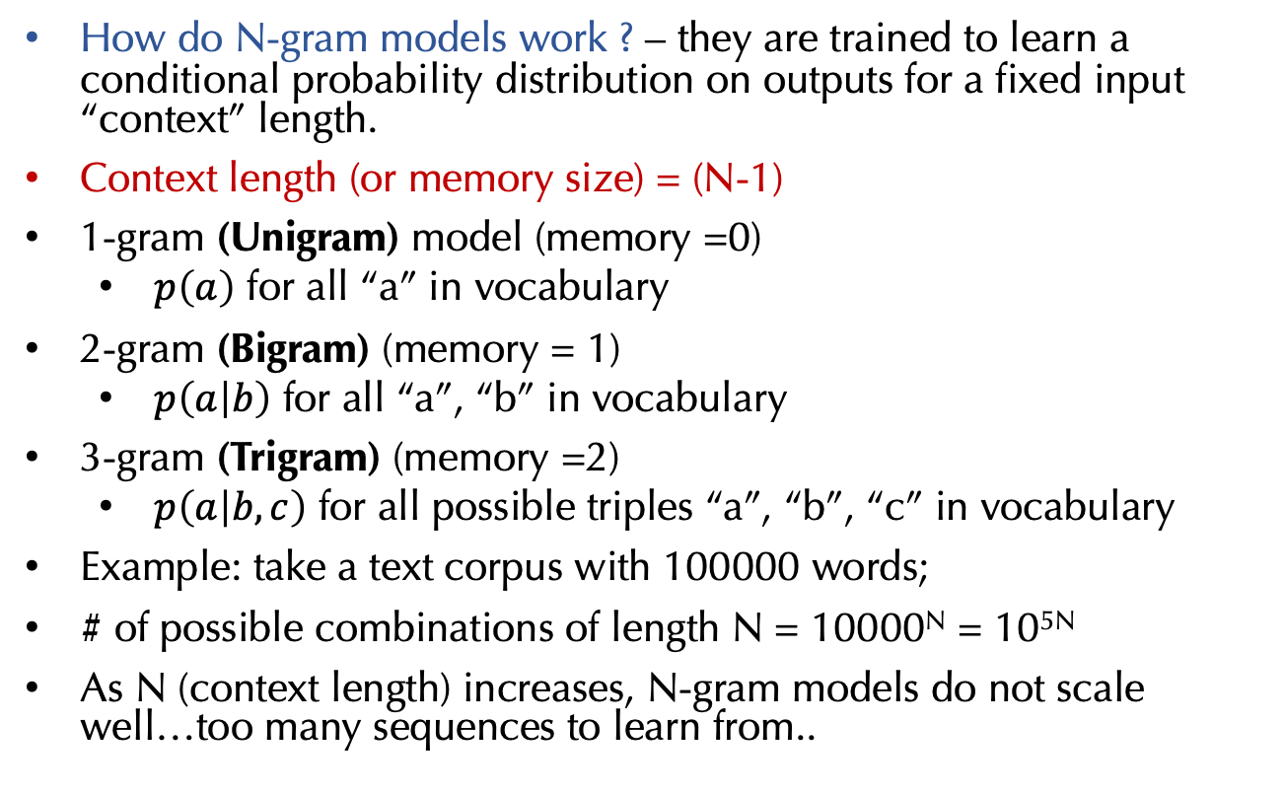
N-Gram Models (1)
How do N-gram models work ? – they are trained to learn a conditional probability distribution on outputs for a fixed input “context” length.
Context length (or memory size) = (N-1)
1-gram (Unigram) model (memory =0)
$p\left(a\right)$ for all “a” in vocabulary
2-gram (Bigram) (memory = 1)
$p\left(a | b\right)$ for all “a”, “b” in vocabulary
3-gram (Trigram) (memory =2)
$p\left(a | b, c\right)$ for all possible triples “a”, “b”, “c” in vocabulary
Example: take a text corpus with 100000 words;
# of possible combinations of length N = 10000^{N} = 10^{5N}
As N (context length) increases, N-gram models do not scale well…too many sequences to learn from..

Slide 5
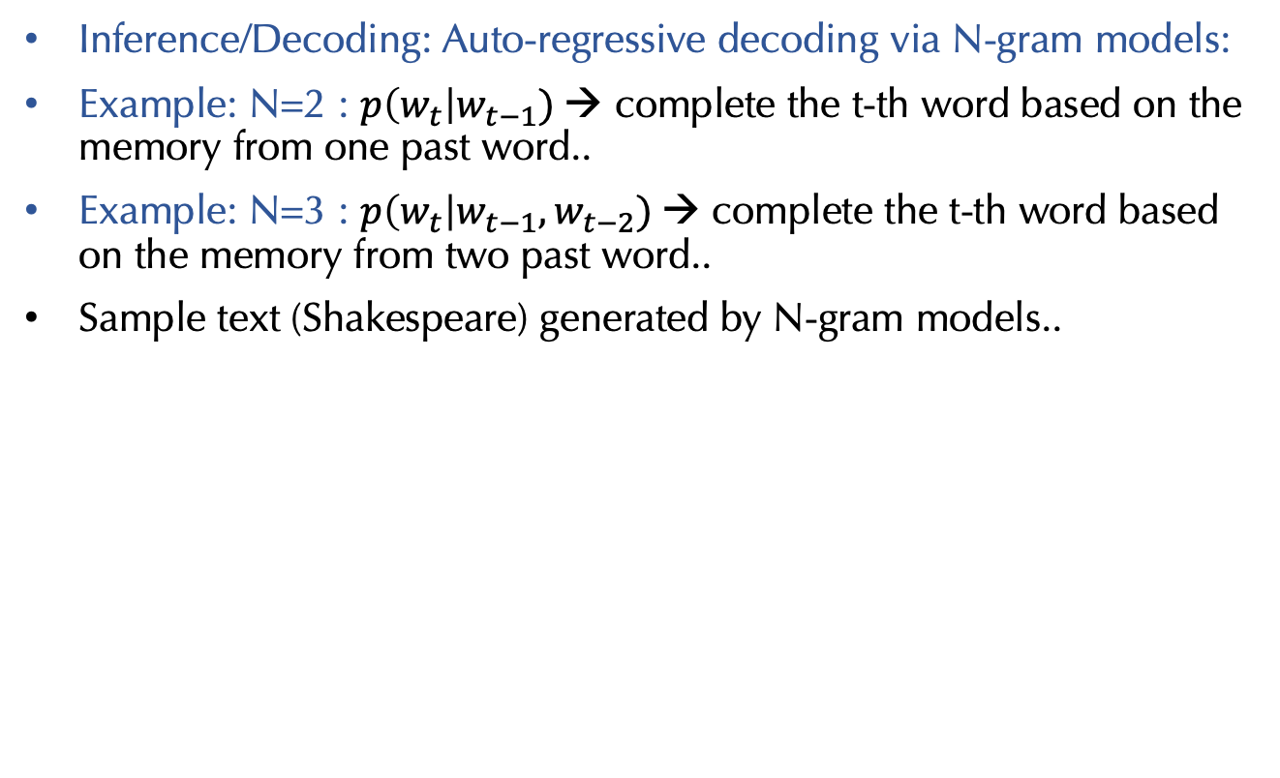
N-Gram Models (2)
Inference/Decoding: Auto-regressive decoding via N-gram models:
Example: N=2 : $p\left(w_{t}\right|w_{t−1})$→ complete the t-th word based on the memory from one past word..
Example: N=3 : $p\left(w_{t}\right|w_{t−1},w_{t−2})$→ complete the t-th word based on the memory from two past word..
Sample text (Shakespeare) generated by N-gram models..

Slide 6
N-Gram Models (3)
Inference/Decoding: Auto-regressive decoding via N-gram models:
Example: N=2 : $p\left(w_{t}\right|w_{t−1})$→ complete the t-th word based on the memory from one past word..
Example: N=3 : $p\left(w_{t}\right|w_{t−1},w_{t−2})$→ complete the t-th word based on the memory from two past word..
Sample text (Shakespeare) generated by N-gram models..

Slide 7
Recurrent Neural Networks (RNNs)

Slide 8
Recurrent Neural Networks (RNNs)
Whh, Wxh
(weights of hidden layers)
Weights shared across
layers! (fewer parameters
to learn)
Wyh
(weights of output layers)

Slide 9
Recurrent Neural Networks (RNNs)
RNNs keep a “hidden” state to track for memory
Weights shared across
layers! (fewer parameters
to learn)
RNNs suffer from vanishing
gradients problem

Slide 10
Long Short Term Memory (LSTMs)
LSTMs introduce a “gating” mechanism for better incorporating memory/context
Forget gate (f): which information to discard from previous cell state
Input gate (i): which information to store in current cell state
Candidate cell state (~c): proposed new candidate valued to be stored in cell state
Cell state ( c) : this is the memory of LSTM with long-term dependencies
Output gate (o): controls what information to be passed from previous hidden state and the output
Hidden state (h): this is the output of LSTM at current time step

Slide 11
LSTM Cell State

Slide 12
LSTM Forget Gate

Slide 13
LSTM Input Gate

Slide 14
LSTM Cell State (again)

Slide 15
LSTM Output Gate

Slide 16
RNNs vs LSTMs

Slide 17
Tokenization in LLMs
What is Tokenization: Tokenization is the process of breaking down text into smaller units (“tokens”) for processing by language models.
Types of tokens for language models:
Words: whole words treated as “tokens”
Sub-words: pieces of words (prefix, suffix etc) can be tokens (most commonly used)
Characters: individual letters or symbols
Word-based Tokenization:
Example: “I love AI.” → [“I”, “love”, “AI”]
Pros: Simplicity.
Cons: Large vocabulary; doesn’t handle rare/misspelled words well.
Subword Tokenization (e.g., Byte-Pair-Encoding (BPE)):
Example: “running” → [“run”, “ning”]
Pros: Compact vocabularies, effective for unseen words.
Cons: More computational complexity.
Character-level Tokenization:
Example: “AI” → [“A”, “I”]
Pros: Handles rare words naturally.
Cons: Long sequences, harder for models to learn dependencies.

Slide 18
Tokenization in LLMs
Each token in Vocabulary is assigned a high-dimensional embedding
(Embedding dim = D)
Model | V (vocabulary size) | D (embedding dim) | Tokenizer
GPT-2 (S, M, L) | 50257 | 768, 1024, 1280 | BPE
GPT-3 | 50257 | 12,288 | BPE
BERT | 30522 | 768 | WordPiece
T5 |  | 32000 | SentencePiece
LLaMA | 32000 | 4096 | SentencePiece
V = # of tokens in the vocabulary
D = Size of the embedding vector for each token
E (embedding matrix) = V x D matrix (can think of it as a look-up table)

Slide 19
Byte-Pair Encoding (BPE): Vocabulary Creation
Goal: given a large text corpus, create a vocabulary of words/sub-words of a desired size which can handle hopefully unseen words. We also need to learn “merge rules”, i.e., if/how to combine adjacent tokens.
Step 1 (initialize tokens)
Corpus: "low lower lowest" Tokens: ["l o w _", "l o w e r _", "l o w e s t _"]
Step 2 (count adjacent pair frequencies)
Pair Frequencies: ("l", "o") → 3, ("o", "w") → 3, ("w", "_") → 3, ("w", "e") → 2, ("e", "r") → 2,
("e", "s") → 1, ("s", "t") → 1
Step 3 (Merge most frequent pair)
Tokens after merging: ["lo w _", "lo w e r _", "lo w e s t _"]
(Keep repeating Steps 2 and 3.. compute new pair frequencies & merge again..)
Pair Frequencies: ("lo", "w") → 3, ("w", "_") → 3, ("w", "e") → 2, ("e", "r") → 2, ("e", "s") → 1, ("s", "t") → 1
Final Vocabulary:["l", "o", "w", "lo", "low", "low_", "e", "r", "s", "t", "_"]
Final Merge Rules:
1. ("l", "o") → "lo" (rule learned in 1st iteration)
2. ("lo", "w") → "low" (rule learned in 2nd iteration)
3. ("low", "_") → "low_” (rule learned in 3rd iteration)..and so on

Slide 20
Byte-Pair Encoding (BPE): Inference Stage
We are provided a Vocabulary of tokens: ["l", "o", "w", "lo", "low", "er", "low_", "er_", "_"]
We are provided the Merge Rules:
1. ("l", "o") → "lo"
2. ("lo", "w") → "low"
3. ("low", "_") → "low_"
4. ("e", "r") → "er"
5. ("er", "_") → "er_"
Goal: given some text, we wish to convert it to a sequence of tokens via BPE
Example: Input is “lower”--> Initial Tokens: ["l", "o", "w", "e", "r", "_"] Next apply merge rules in order
Merge ("l", "o"): Apply Rule 1: ("l", "o") → "lo” Updated Tokens: ["lo", "w", "e", "r", "_"]
Merge ("lo", "w"): Apply Rule 2: ("lo", "w") → "low” Updated Tokens: ["low", "e", "r", "_"]
Merge ("low", "_"): Apply Rule 3: ("low", "_") → "low_” Updated Tokens: ["low_", "e", "r", "_"]
Merge ("e", "r"): Apply Rule 4: ("e", "r") → "er” Updated Tokens: ["low_", "er", "_”
Merge ("er", "_"): Apply Rule 5: ("er", "_") → "er_” Updated Tokens: ["low_", "er_"]
Final Tokens: ["low_", "er_"]
Vocabulary Mapping: "low_" → 6 "er_" → 7
Token IDs: [6, 7]

Slide 21
“Seq2seq” Paper (2014)
Introduced a new approach for sequence-to-sequence translation
Proposed an Encoder-Decoder architecture
Encoder: takes an input sequence and compute a “hidden” representation of input
Decoder: Use hidden representation to sequentially decode/produce output.

Slide 22
“Seq2seq” Paper: Encoder
Given an input sequence X: first tokenize it, say we obtain (x1, x2,..,xT)
Encoder: sequentially process the input and compute hidden representations
h1 = Enc(x1, h0)
h2 = Enc(x2, h1)
h3 = Enc(x3, h2)…and so on till one reaches end: hT = Enc(xT, h(T-1)).
v = hT is the fixed representation of the entire input sequence
Decoder:

Slide 23
“Seq2seq” Paper: Decoder
v = hT is the fixed representation of the entire input sequence
Decoder:
hdec(1) = Dec(V, 0) → Softmax(Whdec(1)+ b(1)) (over vocab) → decode y1
hdec(2) = Dec(V, hdec(1)) → Softmax(Whdec(2) + b(2)) → decode y2
hdec(3) = Dec(V, hdec(2)) → Softmax(Whdec(3) + b(3)) → decode y2
Auto-regressive decoding as before.
Each “Dec(..)” is a trainable LSTM block (“deep” LSTMs were used)

Slide 24
“Seq2seq”: Datasets & Performance Metrics
Used WMT 14 English-to-French Translation Dataset (WMT = workshop on Machine translation)
Training Data: 36 million English-French sentence pairs
Test Data: 4.5 million Eng-Fr sentence pairs
Performance Metric: BLEU Score (Bilingual Evaluation Understudy)
BLEU measures the closeness of a machine translation to human translation
Takes set of MT generated sequences and reference sequences
Measures the n-gram overlap between these two sets of sequences
BLEU Scores range from 0 (no overlap) to 100 (highest overlap)

Slide 25
BLEU Score (Bilingual Evaluation Understudy)
How Does It Work?
Step 1: Tokenization: Split text into words or subwords.
Step 2: n-Gram Precision: Calculate precision for n-grams:
Precision(n) = (Count of Matching n-grams) / (Count of Total n-grams in MT)
Step 3: Brevity Penalty (BP): Penalizes short translations:
BP = 1, if c > r or exp(1 - r/c), if c ≤ r, where c: MT length, r: reference length.
Step 4: Final BLEU Score: Combine precision and BP:
BLEU = BP × exp(Σ (w_n × log Precision_n)) (Default w_n = 1/N).
Example: Reference: The cat is on the mat. MT: The cat is on mat.
- 1-gram precision: 5/5 = 1.0
- 2-gram precision: 3/4 = 0.75
Brevity Penalty: exp(1 - 6/5)
BLEU = 0.82 × exp(0.5 × (log(1.0) + log(0.75))) ≈ 0.71.

Slide 26
“Seq2seq” Paper: Results
Key Takeaway(s) from Seq2Seq paper
Introduced a new approach for sequence to sequence translation
Proposed an Encoder-Decoder architecture
Impressive results on language translation tasks
Shortcomings: reliance on a single hidden representation of the input
Harder to deal with longer sentences.
What next? “Attention is all you need paper”

